Slide 1
ITSC 206: Advanced Networking for Offensive and Defensive Environments
Lecture 8: VPN

Slide 2
Table of Contents
Module 7 Review
Motivation
Business Drivers
Threats from the Internet
What is VPN
Types of VPN
Algorithms
IPSEC
SSL/TLS VPN
PPTP VPN

Slide 3
Virtual Private Networks (VPNs)

Slide 4
Review Module 7
IDS
IPS
Types of IDS/IPS
Detection Methods
IDS/IPS Example
How IPS Snort Works

Slide 5
Virtual Private Networks (VPNs)

Slide 6
Motivation
Remote Access
Dramatic increase in telecommuting and mobile work force
Reduce costs by using local access to internet, rather than long distance or “toll free” service
Intranets
High cost of implementing and maintaining private networks
Reduce costs by removing point-to-point leased lines and make broader use of internet connectivity
Extranets
Secure transactions on-line with suppliers and business partners
Reduce cost by eliminating dependence on dedicated connections

Slide 7
Business Drivers
Cost
Eliminate remote access equipment, toll costs, leased lines
60 - 80% operational savings
SVPN equipment payback 4-6 months
Leverage the Internet
global connectivity
instant scalability
thousands of users or nodes
variety of connectivity options
modem, ISDN, cable modem, xDSL
multi-vendor interoperabitity

Slide 8
Threats From the Internet
IP Spoofing
Eavesdropping (sniffing)
Session Hijacking
Man-in-the-Middle attack
Authentication Replay
Attacker “sniffs” valid authentication information and uses it again to create additional authenticated sessions

Slide 9
Security Services - Secure VPNs
Confidentiality
prevent disclosure of data communications
Integrity
detection of data modification
Authentication
positive identification of network users
protection against spoofing attacks
Network access control (VPN policy)
access privileges for the network & resources

Slide 10
What is a VPN?
A Virtual Private Network (VPN), as the name implies, is a private network that is virtualized over a public network using encapsulation and encryption technologies
VPN is typically deployed over the Internet, but it can also be used within private networks or over WAN or carrier networks (e.g., MPLS) to provide confidentiality and integrity on the communication channel

Slide 11
What is VPN?
Confidentiality: VPN applies encryption on the VPN traffic to protect against network sniffing
Integrity: Message integrity is provided to ensure VPN traffic is free from tampering
Authentication: Prevents unauthorized access to the VPN service

Slide 12
Types of VPN: Site-to-Site VPN
Used to connect sites from different locations, usually back to headquarters, securely over the public network (e.g., Internet)
Used to extend the corporate network to branch offices, making network resources available through the VPN at the Internet layer (L3)
Established between network gateways, so individual computers do not need to run VPN software to access the other sites

Slide 13
Gateway-To-Gateway
SA
Intranet/Internet
H1
G1
G2
H2
Local Intranet
Local Intranet
Only Tunnel Mode Allowed
[IP2][AH][HP1[payload]
[IP2][ESP][IP1][payload]

Slide 14
Types of VPN: Remote Access VPN
Allows remote user to establish secured connections to the corporate network from a remote location
Users can access the corporate network resources via the VPN as if they were directly connected to the network

Slide 15
Types of VPN: Remote Access VPN
Remote user has VPN client software that connects to the corporate VPN server, performs authentication and establishes the VPN tunnel to the corporate network
Suitable for individual users who are roaming but still require connectivity to corporate resources

Slide 16
Remote VPN - Host-To-Gateway
SA1
Intranet/Internet
H1
G2
H2
Remote Host
Local Intranet
Note: Requires special processing of the IPSec header order

Slide 17
Remote Access Authentication
Username and password: Remote access authentication requires, at minimum, a username and password login. Authentication is typically tied in with Active Directory to allow users to use Windows login for remote access
AAA: Smaller implementations may choose to authenticate user with an AAA server, and maintain user credentials in a simplified database inside a Radius server

Slide 18
Remote Access Authentication
2FA (two factor authentication): used to increase security on remote access authentication
Requires the user to have two of the following factors for authentication:
Something you know (secret, password)
Something you have (tokens, USB key)
Something you are (fingerprint, retina scan)
Username and password is a good first factor authentication (something you know). RSA token or Google Authenticator are good options for the second factor authentication (something you have)

Slide 19
Algorithms

Slide 20
Symmetric Encryption Algorithms
DES (Data Encryption System)
64-bit input blocks, 16 round processing, 56-bit key
Since key space quite small, it has been broken
2DES
Double the encryption of DES (two 56-bit keys)
Because vulnerable to meet-in-the-middle attack, it has been broken
3DES
In simplest terms, performs DES three times
Effective key strength is 168 bit.
Considered a legacy algorithm, replaced by more advanced algorithms like AES

Slide 21
Symmetric Encryption Algorithms
CCMP
Counter mode with cipher block chaining message authentication code protocol
Part of 802.11i standard for WiFi networks
Based on AES using CTR with CBC-MAC
Rijndael (AES128, AES256)
Finalist for the AES standard,
Block size: 128, 192 or 256 bits (AES implementations use only 128 bit block size)
Key size: 128, 192 or 256 bits, variable rounds.
Four major operations: substitute bytes, shift rows, mix columns and add round key

Slide 22
Asymmetric Encryption Algorithms
RSA
Popular public key cryptosystem, based on mathematical challenge of prime number factoring.
Public key, based on two large prime numbers, is used to encrypt the message. Only the private key with the prime numbers can decrypt the message
Diffie-Hellmann Algorithm
Key exchange algorithm used to create a secret symmetric key between two parties over public networks
Used heavily in PKI
Does not include message confidentiality

Slide 23
Asymmetric Encryption Algorithms
El Gamal
Based on Diffie-Hellmann but includes message confidentiality and digital signature
ECC
Highest strength per bit
Fast and efficient on resource-constrained devices, such as cell phones and smart card readers
Includes confidentiality, digital signature and message authentication

Slide 24
Internet Protocol Security (IPSec)

Slide 25
IPSec Overview
Internet Protocol Security (IPSec) is one of the most common VPN protocols used today
Works at the Internet layer (L3) of the OSI model, securing all data communication layer 3 and above

Slide 26
IPSec Overview
A suite of network protocols that work together to provide authentication and encryption of data packets over a network
Provides security for gateway-to-host (remote access) or network-to-network (site-to-site) connections

Slide 27
Authentication Header (AH)
AH is used to authenticate IP traffic but doesn’t encrypt it
AH uses HMAC (MD5 or SHA) to validate the authenticity and integrity of a message
IP
AH
Payload
Signature

Slide 28
IPSec Authentication Header
IP Header
AH
Payload
Next Header
Payload length
Reserved
Security Parameters Index
Sequence Number
Authentication Data (variable size)
32 bits

Slide 29
Encapsulating Security Payload (ESP)
ESP includes the encryption and authentication of a payload in the IPSec protocol suite
Provides authenticity, confidentiality and integrity of the payload
Can be implemented with or without authentication, although without authentication is insecure
IP
ESP
Encrypt
Transport & data
Signature

Slide 30
Encapsulating Security Payload (ESP)
Can also be implemented with an encryption algorithm (e.g., DES, 3DES, AES) to provide confidentiality
Can be implemented with a NULL algorithm to forego confidentiality and use only the authentication feature (similar to AH)

Slide 31
IPSec ESP Packet
IP Header
ESP Header
Payload
ESP Trailer
ESP Trailer
32 bits
Security Parameters Index
Sequence Number
Encryption
Encryption
Padding
Padding
Pad Length
Next Header
Authentication Data (variable size)

Slide 32
Transport Mode
One of two modes IPSec operates in
Encapsulates the payload only and is used for communication between two hosts
IP protocol headers are left untouched
If authentication header is used, performing NAT will break transport mode because NAT invalidates the hash value

Slide 33
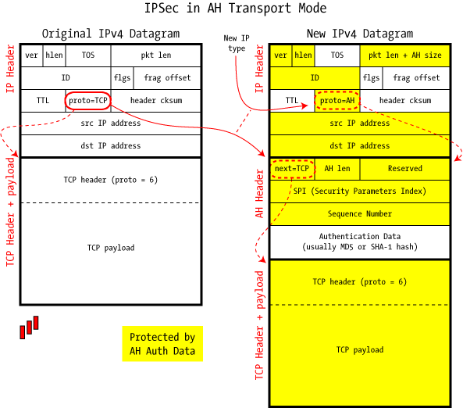
Transport Mode
http://www.unixwiz.net/images/IPSec-AH-Transport-Mode.gif

Slide 34
Tunnel Mode
Entire IP packet is encapsulated inside the tunnel
A new IP header is created for the tunnel traffic
Since original IP packet is encapsulated and encrypted, it is impossible to determine the nature of the original IP packet (Src and Dst IP, ports, protocols)

Slide 35
Tunnel Mode
Tunnel mode is typically used between gateways to provide VPN functionality across untrusted networks (e.g., Internet) for site-to-site communication or host-to-network (remote user access) communication
Supports NAT traversal because the entire original IP packet is encapsulated

Slide 36
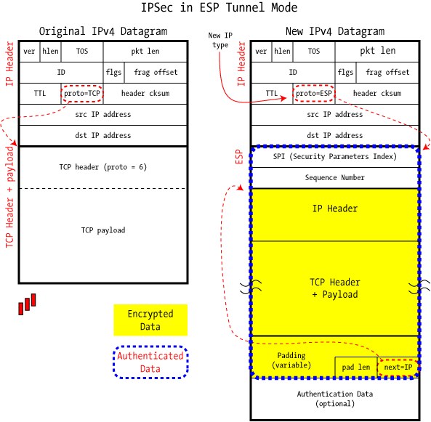
Tunnel Mode
http://www.unixwiz.net/images/IPSec-ESP-Tunnel-Mode.gif

Slide 37
Internet Key Exchange (IKE)
Used to build the security association of an IP communication flow
IPSec bulk data encryption typically uses a symmetric cryptographic algorithm to achieve reasonable performance (asymmetric algorithm is too slow for bulk data transfer)
Symmetric algorithm requires that both sides use the same key for encryption and decryption
This key must be securely created and maintained by both sides

Slide 38
Internet Key Exchange (IKE)
IKE provides a mechanism to create symmetric keys by both sides independently, without transmitting it
Uses slow, asymmetric algorithm to establish a symmetric key, then uses it for fast, symmetric algorithm for bulk data transfer
Provides the platform for both sides to authenticate and agree on encryption methods and integrity
Result of IKE negotiation is the Security Association

Slide 39
How Does IKE Work? Phase 1
IKE is negotiated in two phases:
The first phase of IKE begins with peer authentication
The authentication can either use a pre-shared key (PSK), signatures or public key encryption
Using Diffie-Hellman protocol, both sides can independently create the shared secret to be used in phase 2

Slide 40
How Does IKE Work? Phase 1
Outcome of IKE phase 1:
IKE SA, an agreement of shared keys (DH key) and methods for setting up IKE phase 2
At the end of phase 1, the two sides have authenticated each other and negotiated keying material, and have created an encrypted tunnel (control channel) to be used in phase 2 for setting up the ESP SA
Phase 1 can be negotiated in 2 modes: Main mode and Aggressive mode

Slide 41
How Does IKE Work? Phase 1
Video
https://www.khanacademy.org/computing/computer-science/cryptography/modern-crypt/v/diffie-hellman-key-exchange-part-2

Slide 42
Main Mode
In Main mode, the IKE phase 1 exchange consists of six packets:
Two packets for initiator sending and responder accepting SA proposal, which consists of authentication, encryption, key lifetime and perfect forward secrecy definition. Multiple proposals can be offered at the same time
Two packets for sending key materials (Diffie-Hellman) between initiator and responder
Two packets for secure authentication of peers using the DH key from step 2 to establish the IKE SA
Six packets results in slower setup time but peer authentication is performed in secured channel

Slide 43
Aggressive Mode
In Aggressive mode, the IKE phase 1 exchange consists of only three packets:
One packet for initiator to send SA proposal, DH key materials and authentication (unsecured) to responder
One packet for responder to reply with accepted SA proposal, DH key material, authentication (unsecured) to initiator and establishment of IKE SA
One packet from initiator to responder to complete establishment of IKE SA
This results in faster setup time but peer authentication (Peer ID) is passed in the clear text

Slide 44
How Does IKE Work? Phase 2
The second phase of IKE has one mode, called Quick mode
Starts with key and methods obtained from IKE SA, the basis for IPSec policy negotiation
Two sides negotiate the IPSec Security Association: encryption and integrity algorithm
The result: IPSec SA is used to create an IPSec tunnel to encrypt the actual data packets communicated between two sides (data channel)

Slide 45
SSL/TLS VPN

Slide 46
Overview
SSL VPN uses the Secure Socket Layer protocol to establish VPN functionality
Typically initiated from a portal via HTTPS protocol
Remote users log into an SSL VPN portal via HTTPS, and initiate a SSL VPN connection
Traffic between web browser and SSL VPN server is tunneled through the secure socket layer

Slide 47
Overview
Communication is a pure SSL connection, and actual traffic is tunnelled within SSL
SSL tunnelling nature makes it NAT- and firewall-friendly
Another advantage is the clientless feature.
No installation of a VPN application required on client computer
Allows the remote user to use any trusted computer to access the SSL VPN without software installation, increasing mobility

Slide 48
Types of SSL VPN: SSL VPN Portal
Provides the remote user access to different, predefined network resources/applications
Users are not allowed access to any network resources that are not defined in the portal
The SSL VPN portal gives greater control of user network access to improve security, and simplifies the user experience with the portal page

Slide 49
Types of SSL VPN: SSL VPN Tunnel
Building on the advantages of SSL protocol, an SSL VPN tunnel provides access to network resources via an installed client
A VPN tunnel can be established over SSL protocol, and provides access to the corporate network, similar to an IPSec client
The difference is that the SSL VPN client leverages SSL protocol to work around NAT and firewall issues, giving better connectivity to remote users

Slide 50
SSL VPN Vulnerabilities
SSL VPN is based on Secure Socket Layer protocol to provide encryption
It is only as secure as SSL protocol itself
Recent SSL vulnerabilities have rendered SSL protocol a highly vulnerable technology
Many companies, including financial institutions, have begun dropping SSL (all versions) in favour of TLS v1.2+

Slide 51
Point-to-Point Tunnelling Protocol (PPTP)

Slide 52
Overview
Point-to-Point Tunneling Protocol (PPTP) is an old VPN technology proposed by Microsoft and other companies
It is an extension to the Internet’s Point-to-Point protocol (PPP, layer 2 protocol)
It encapsulates PPP frames into IP datagrams for transmission over IP networks

Slide 53
Overview
PPTP is a standard VPN technology available on Microsoft Windows Remote Access Server
Uses a control channel for tunnel management and a data channel for the actual data tunneling

Slide 54
How Does PPTP Work?
PPTP uses TCP port 1723 to create and manage a tunnel with the peer
This is the control channel
PPTP then uses a modified version of the Generic Routing Encapsulation (GRE) to encapsulate PPP frames into the tunnel.
This is the data channel
With the PPP frame (layer 2 connectivity) encapsulated in GRE tunnel (layer 3 delivery mechanism), other protocols like IP and NetBEUI can be carried over the PPTP tunnel

Slide 55
PPTP Vulnerabilities
There are many security vulnerabilities associated with the PPTP protocol, associated with the authentication protocols used by PPP (the underlying protocol in PPTP)

Slide 56
PPTP Vulnerabilities
MS-CHAP-v1 is known to be broken. There are existing tools to extract the NT password hashes from a MS-CHAP-v1 traffic capture
MS-CHAP-v2 is susceptible to dictionary attacks on challenge response packets by existing tools

Slide 57
© 2017, Southern Alberta Institute of Technology. All rights reserved.
This publication and materials herein are protected by applicable intellectual property laws. Unauthorized reproduction and distribution of this publication in whole or part is prohibited.
For more information, contact:
Director, Centre for Instructional Technology and Development
Southern Alberta Institute of Technology
1301 16 Ave. N.W., Calgary, AB T2M 0L4

